Slide 1
CodeKataBattle platform
Tommaso Pasini – Elia Pontiggia – Michelangelo Stasi
Politecnico di Milano
15th February 2024

Slide 2
RASD

Slide 3
Goals of the software
ID | Description
G1 | Educators can create tournaments that involve coding battles to challenge students.
G2 | Provides educators with the ability to track student software development knowledge
G3 | Students can improve their software development skills by taking part in coding tournaments and battles where they must write programs
G4 | Coding battles enable students to enhance their soft skills, such as communication, collaboration, and time management, by creating teams and collaborating with the members

Slide 4
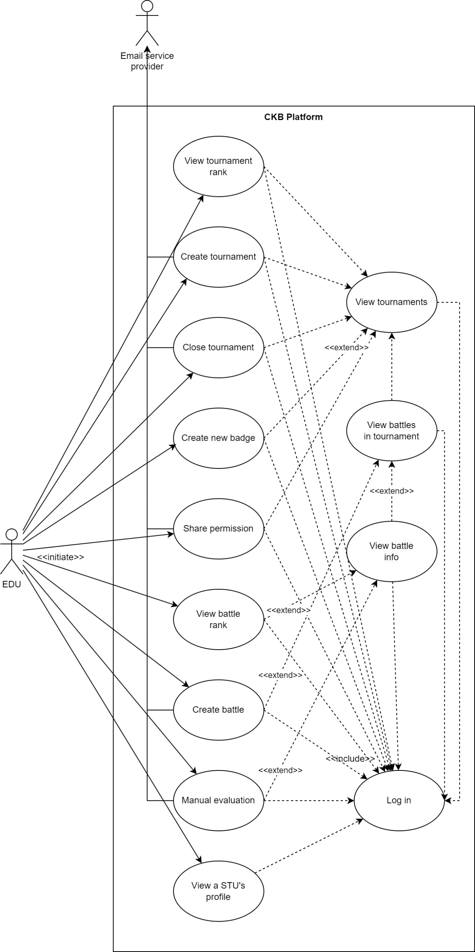
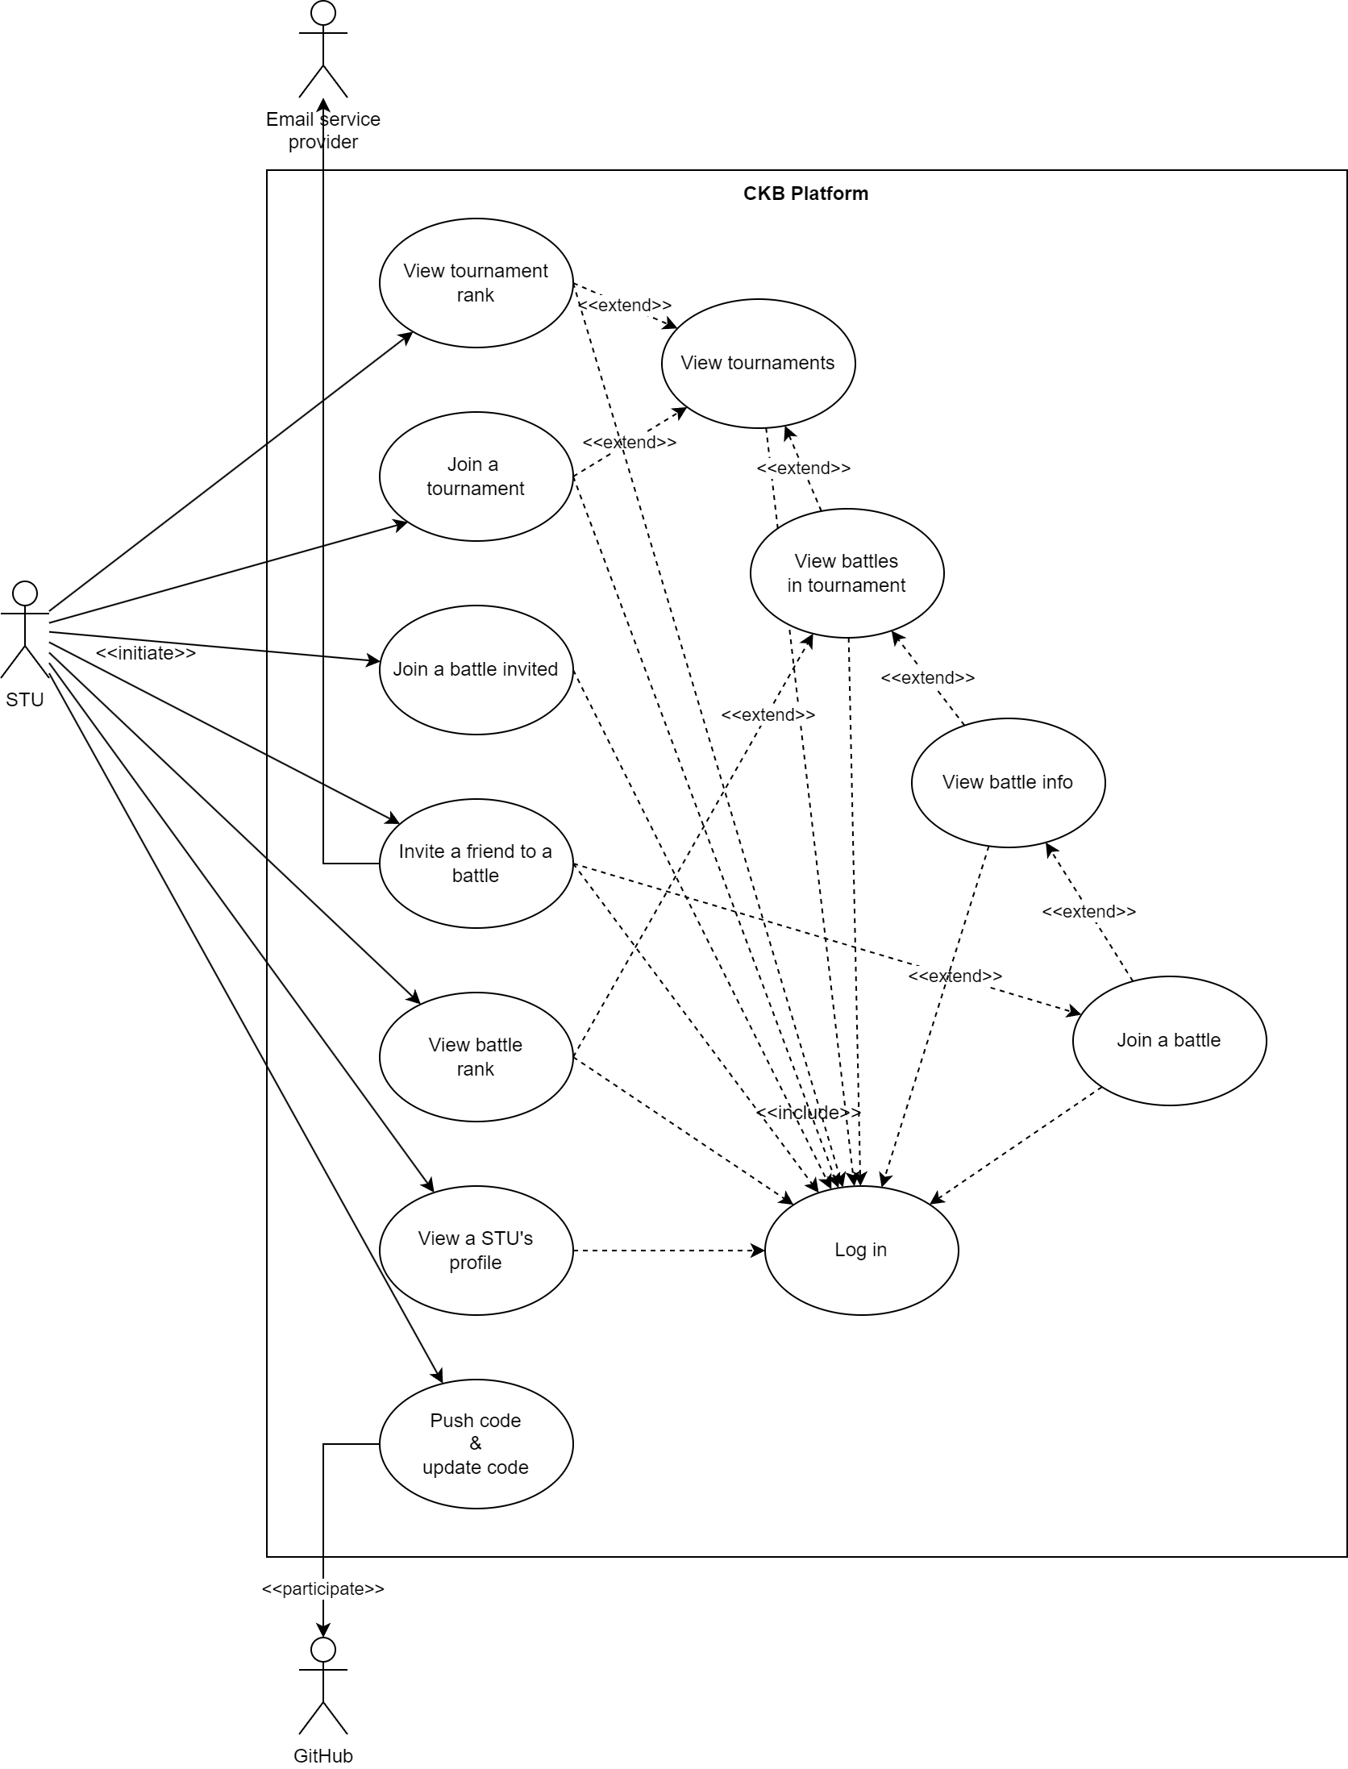
Summary of use cases
Educator
Student
Notes:
The register / login use cases are skipped because they are trivial

Slide 5
Summary of use cases
Student
Educator
Notes:
The register / login use cases are skipped because they are trivial

Slide 6
Summary of requirements
Area | EDU | STU
Login / Register
Actions on tournaments | Creation Closure Share permission Creation of battles within Definition of gamification badges | Subscription
 | Visualization of ranking with points Visualization of ongoing and ended
Actions on battles | Creation, manual evaluation, inspection of source code | Joining via invite Formation of a team Invitation of other STUs Upload the code Access the GitHub repo Get the score updated
 | Visualization of ranking with points Visualization of ongoing and ended
Actions on badges | Creation Definition of new rules Visualization of all created
Get notifications
Inspection of a STU profile

Slide 7
Summary of requirements
Area | EDU | STU
Login / Register
Actions on tournaments | Creation Closure Share permission Creation of battles within Definition of gamification badges | Subscription
 | Visualization of ranking with points Visualization of ongoing and ended
Actions on battles | Creation, manual evaluation, inspection of source code | Joining via invite Formation of a team Invitation of other STUs Upload the code Access the GitHub repo Get the score updated
 | Visualization of ranking with points Visualization of ongoing and ended
Actions on badges | Creation Definition of new rules Visualization of all created
Get notifications
Inspection of a STU profile

Slide 8
Summary of domain assumptions
The users behave correctly
All the systems external to the software (GitHub, mail provider, static analysis tool…) work correctly and are reliable
Notes:
Point one means two things:
- the users do not try to break the system, they insert trhutful data and eventually upload the correct files the system asks (DA 2, 3, 4, 5, 7)
- the STUs follow correctly the rules imposed by the EDUs: they use the intended programming languages during battles and form teams respecring the boundaries (in theory our system already checks for these kind of misuse, but if we assume it it is better for everyone)

Slide 9
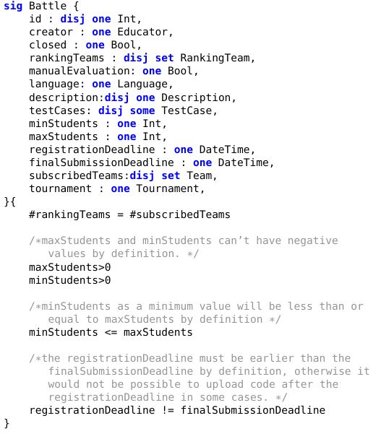
Alloy main features
Properties of Battle
Need of the Bool entity
teamSizeInBoundaries
noStudentInTwoTeams
Uniqueness of User, Tournament and Battle
Notes:
Formal notation for specifying models of systems and software. Supporting tool to simulate specifications and perform formal verification of properties. Useful to formally describe the domain and its properties or operations that the machine must provide. Automated formal verification.

Slide 10
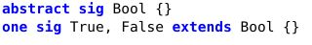
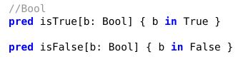
Alloy main features
Properties of Battle
Need of the Bool entity
teamSizeInBoundaries
noStudentInTwoTeams
Uniqueness of User, Tournament and Battle
Notes:
Formal notation for specifying models of systems and software. Supporting tool to simulate specifications and perform formal verification of properties. Useful to formally describe the domain and its properties or operations that the machine must provide. Automated formal verification.

Slide 11
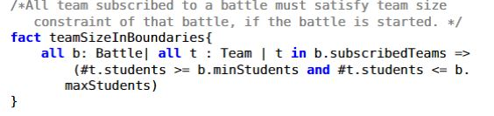
Alloy main features
Properties of Battle
Need of the Bool entity
teamSizeInBoundaries
noStudentInTwoTeams
Uniqueness of User, Tournament and Battle
Notes:
Formal notation for specifying models of systems and software. Supporting tool to simulate specifications and perform formal verification of properties. Useful to formally describe the domain and its properties or operations that the machine must provide. Automated formal verification.

Slide 12
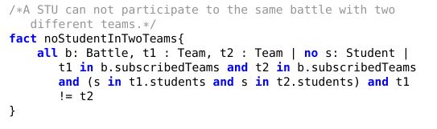
Alloy main features
Properties of Battle
Need of the Bool entity
teamSizeInBoundaries
noStudentInTwoTeams
Uniqueness of User, Tournament and Battle
Notes:
Formal notation for specifying models of systems and software. Supporting tool to simulate specifications and perform formal verification of properties. Useful to formally describe the domain and its properties or operations that the machine must provide. Automated formal verification.

Slide 13
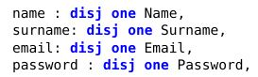




Alloy main features
Properties of Battle
Need of the Bool entity
teamSizeInBoundaries
noStudentInTwoTeams
Uniqueness of User, Tournament and Battle
Notes:
Formal notation for specifying models of systems and software. Supporting tool to simulate specifications and perform formal verification of properties. Useful to formally describe the domain and its properties or operations that the machine must provide. Automated formal verification.

Slide 14
DD

Slide 15
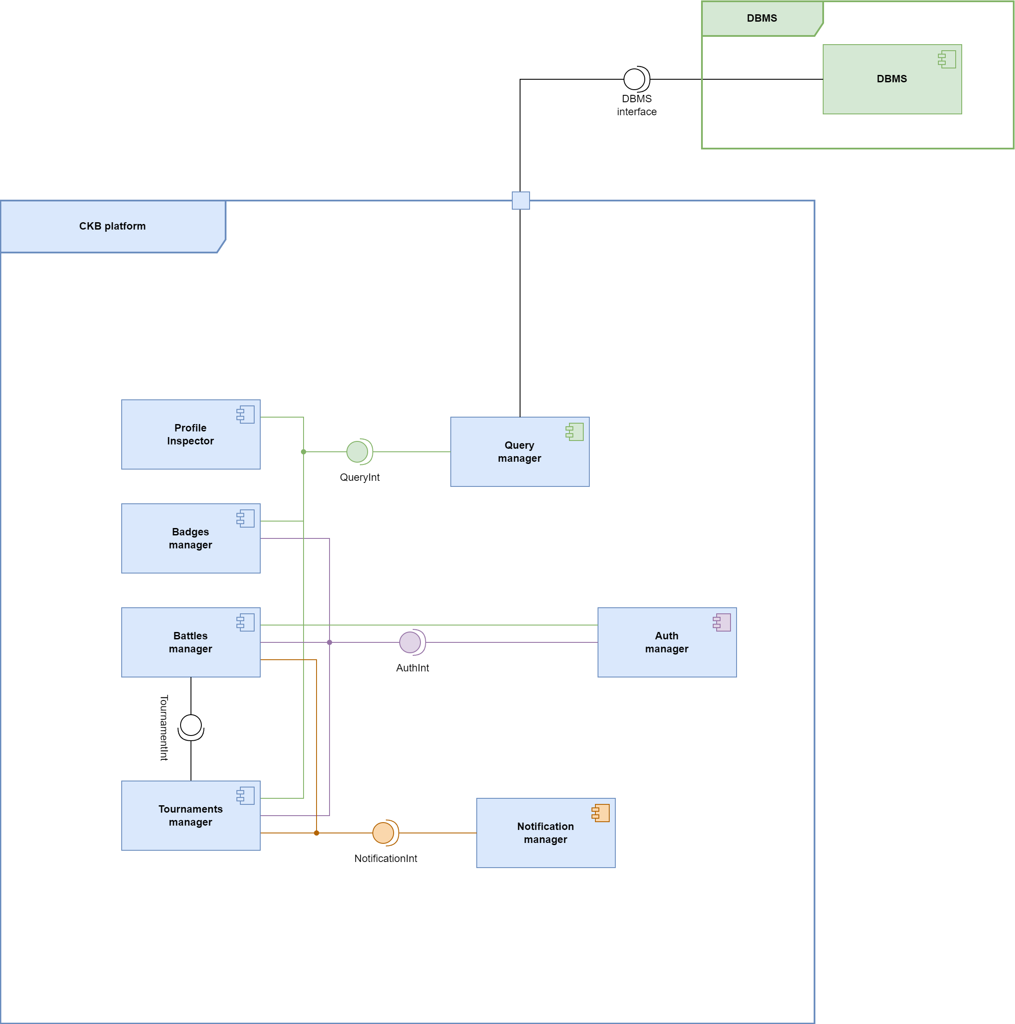
Software components

Slide 16

Interfaces to WebApps
Profile inspector interface
Badges action interface
Battles action interface
Auth manager interface
Tournaments action interface

Slide 17
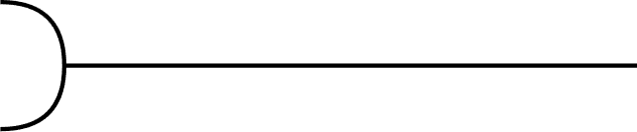
External interfaces
Profile inspector interface
Badges action interface
SonarQube API
Battles action interface
Auth manager interface
GitHub API
Tournaments action interface
Mail API

Slide 18
Selected styles & architectures
Client
RESTful API
Server
Single page webapp

Slide 19
Selected styles & architectures
View
Controller
Model
Server
Client
RESTful API
Web server
App
server
Database
Single page webapp
Relational

Slide 20
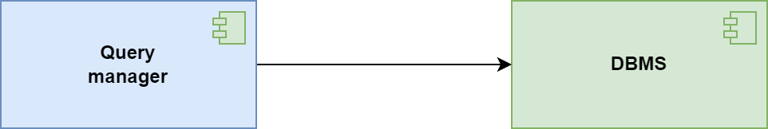
Test plan

Slide 21
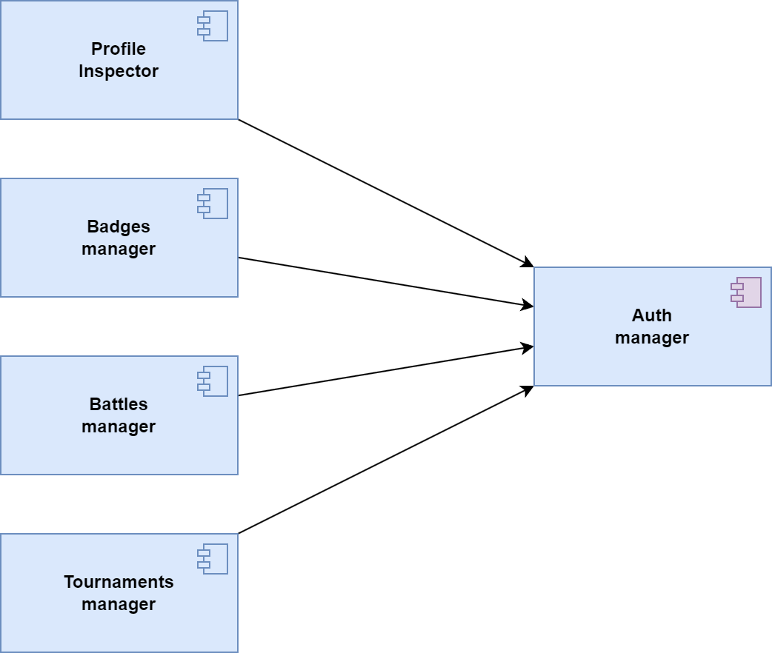
Test plan

Slide 22
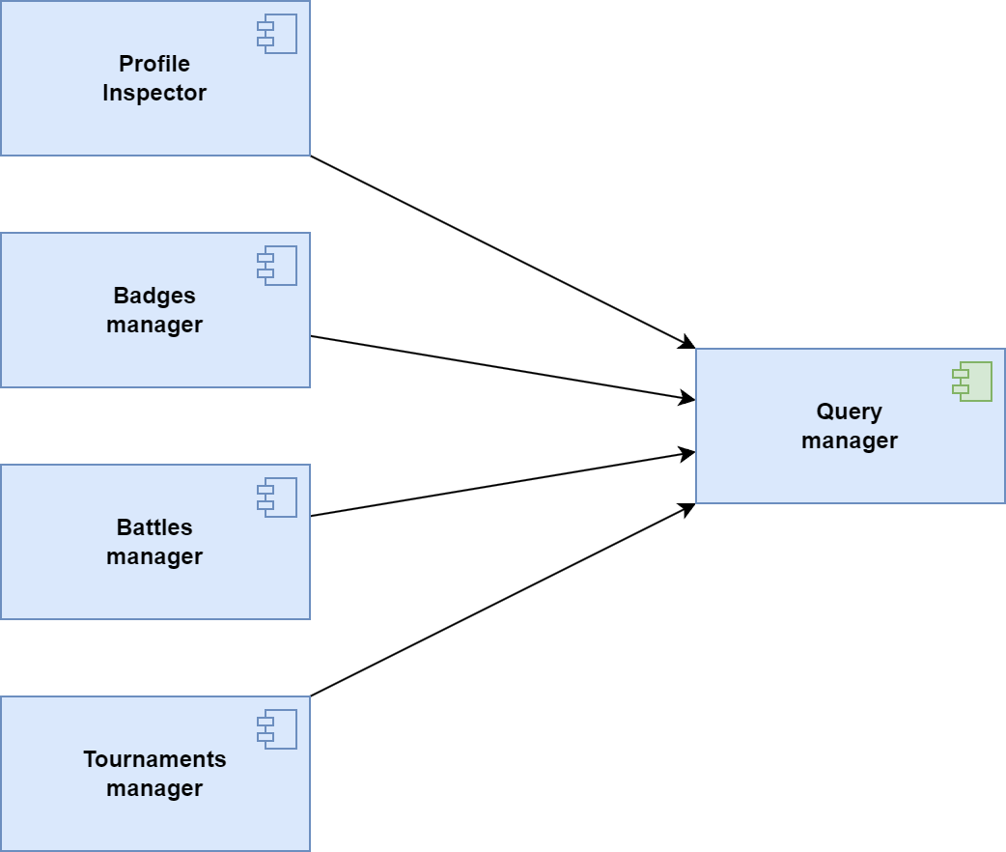
Test plan

Slide 23
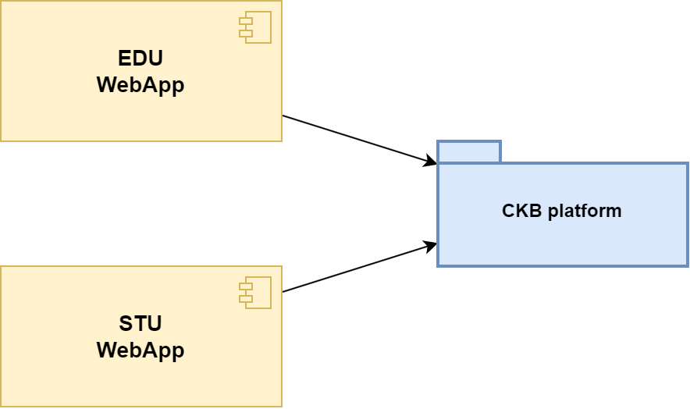
Test plan

Slide 24
Implementation

Slide 25






Framework
Front – end Back – end
HTML
Java Spring
CSS
MySQL
JavaScript

Slide 26
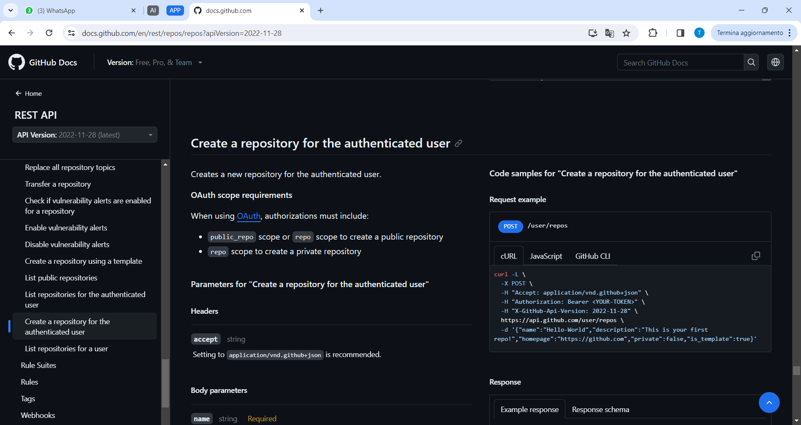
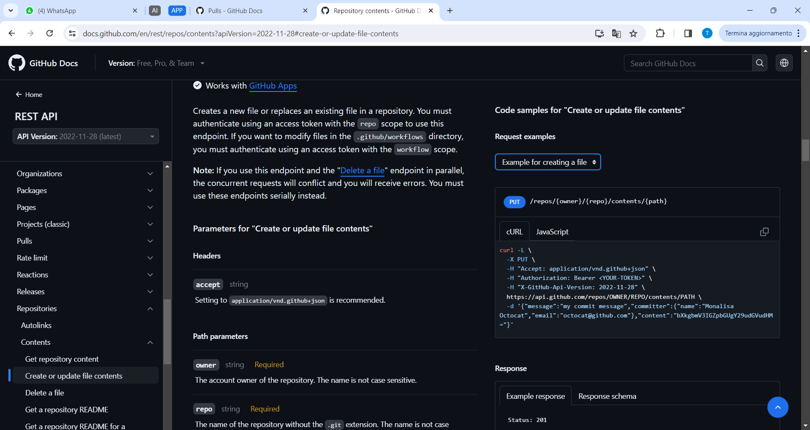
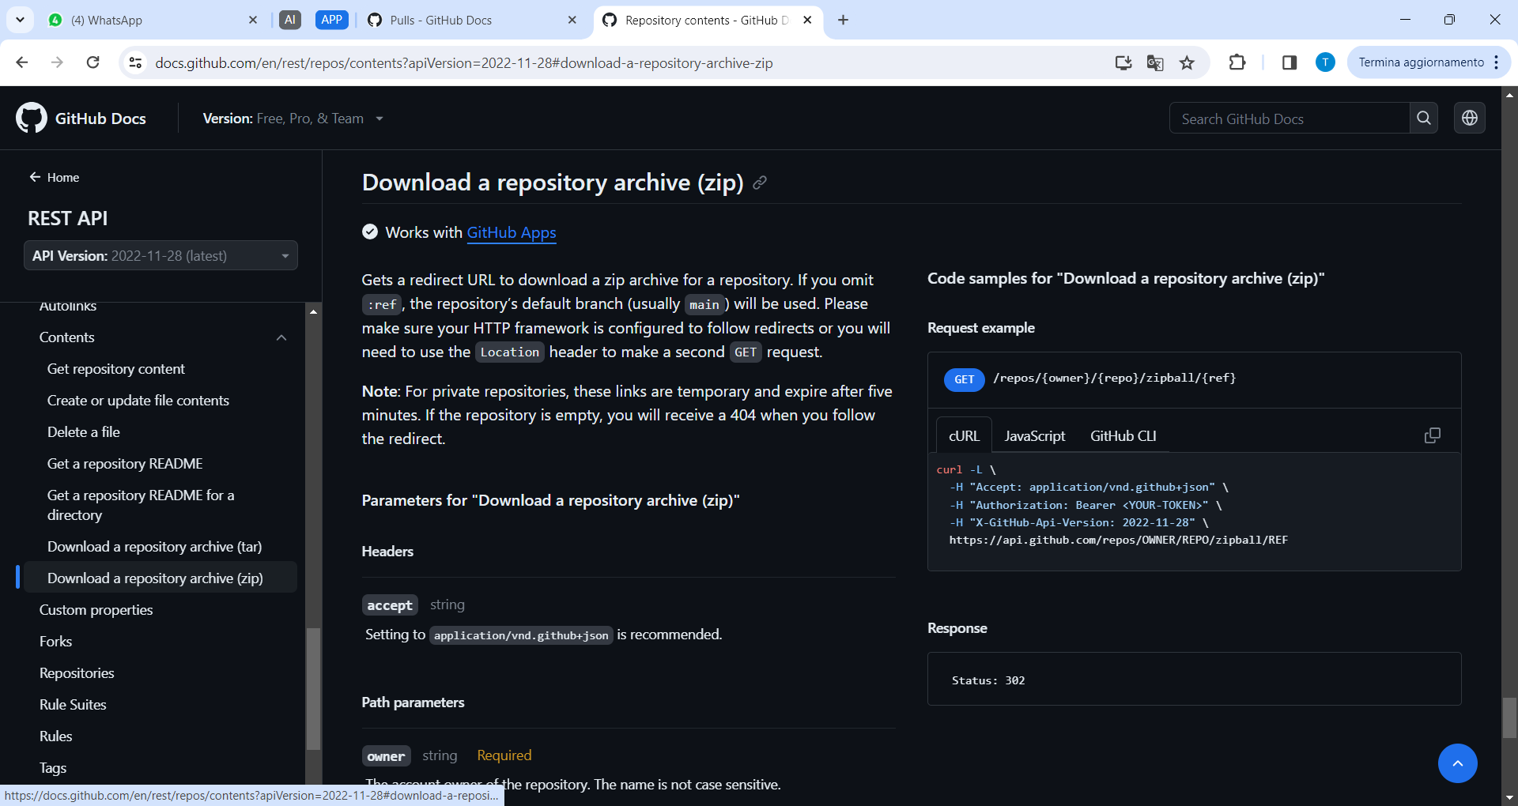
Algorithmic solutions
Mainly POST and GET that insert or retreive data from the DB
GitHub API:
Generate Repository
Upload File into Repository
Pull Repository into Zip
Gmail API:
Send Email
SonarQube

Slide 27
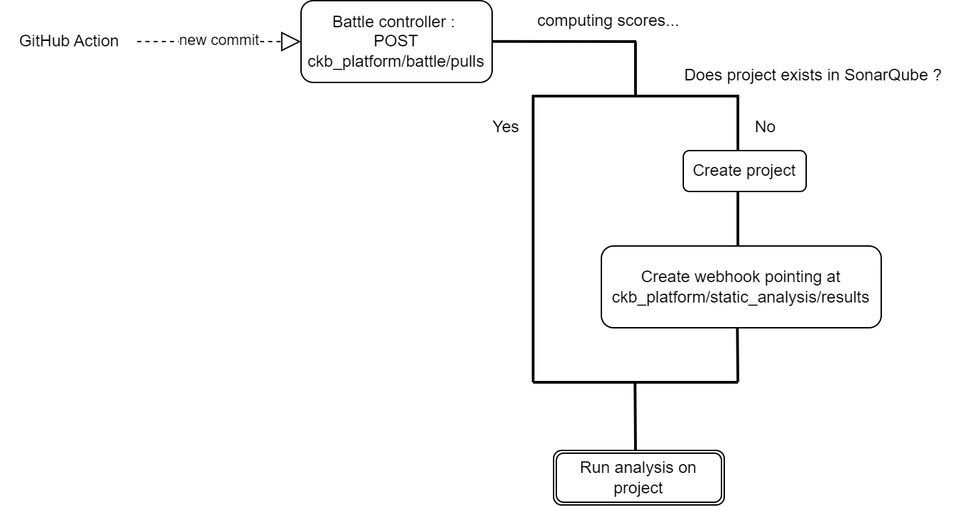
Static Analysis Tool
SonarQube
Notes:
Why SonarQube? Analyze the code quality of 30+languages. Fast analysis, easy to integrate with their api

Slide 28
Static Analysis Tool
SonarQube
When the analysis is finished…

Slide 29
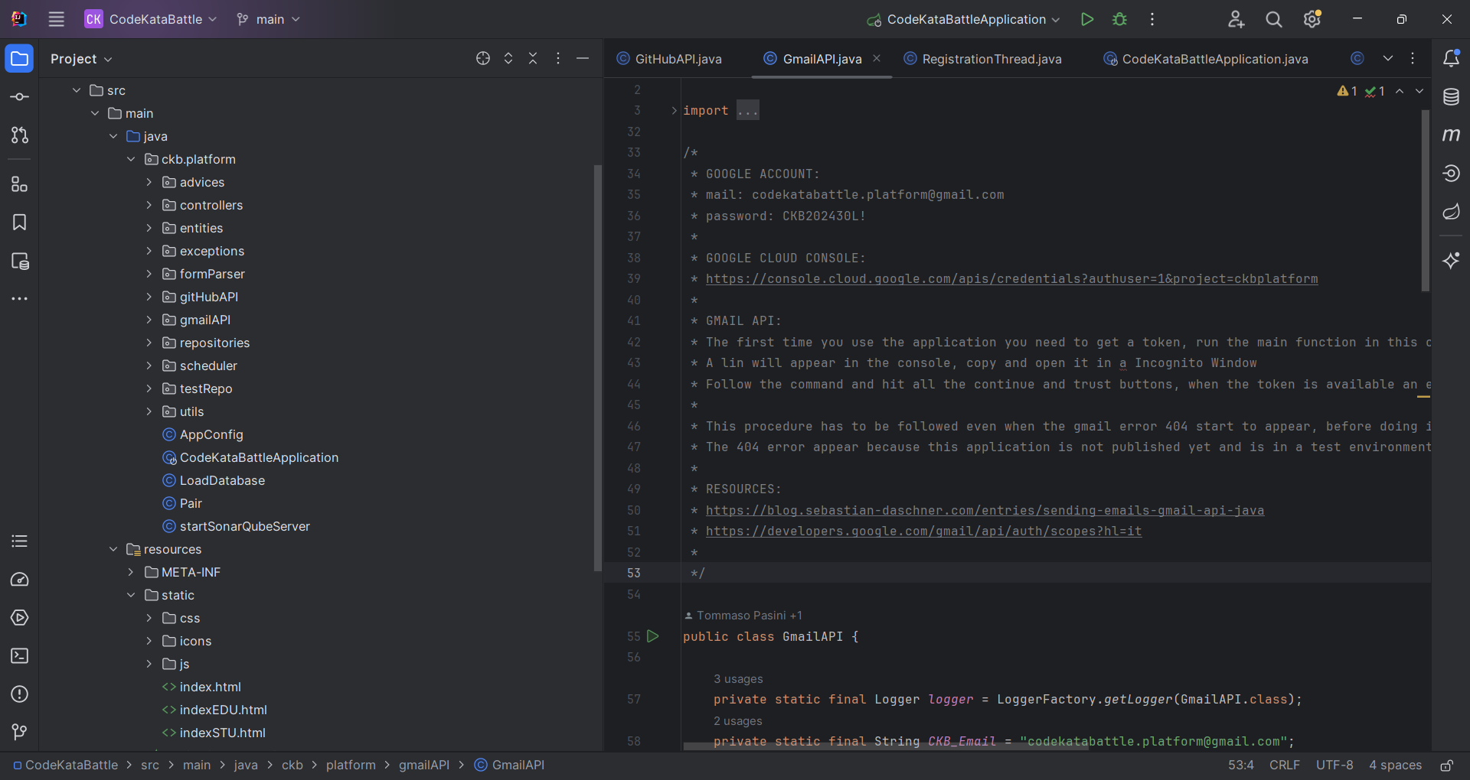
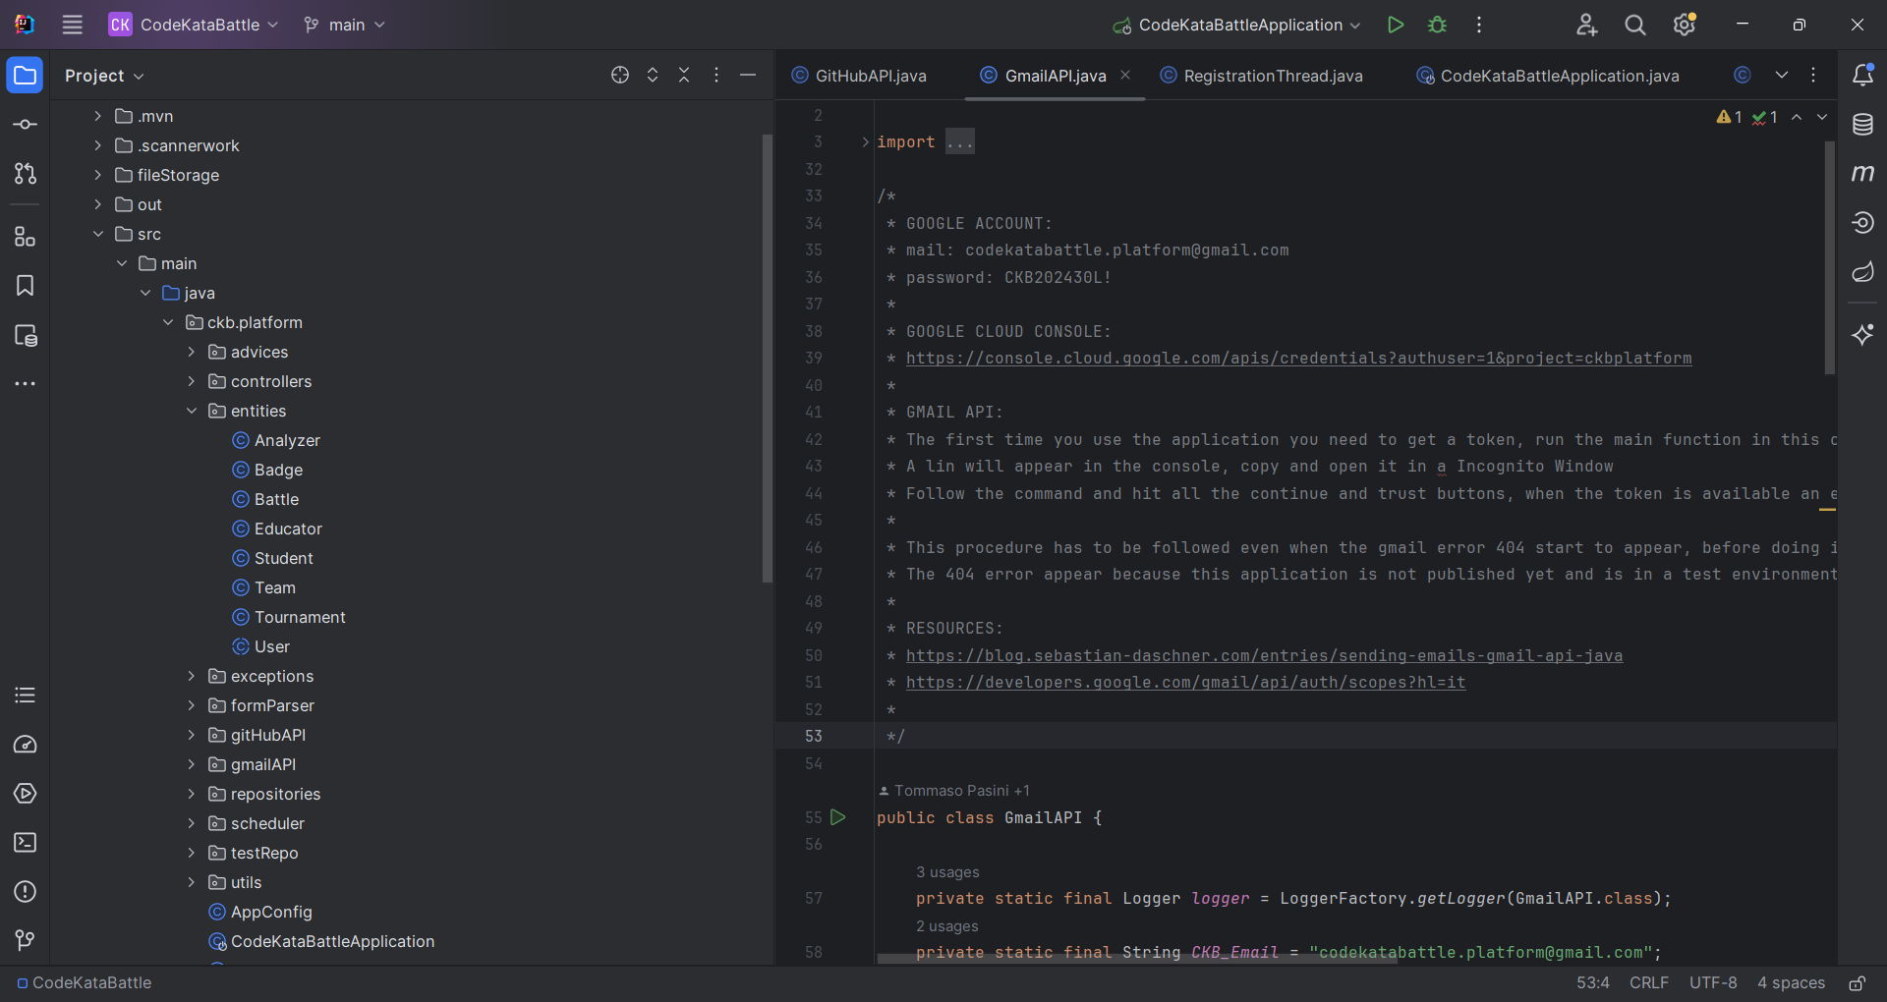
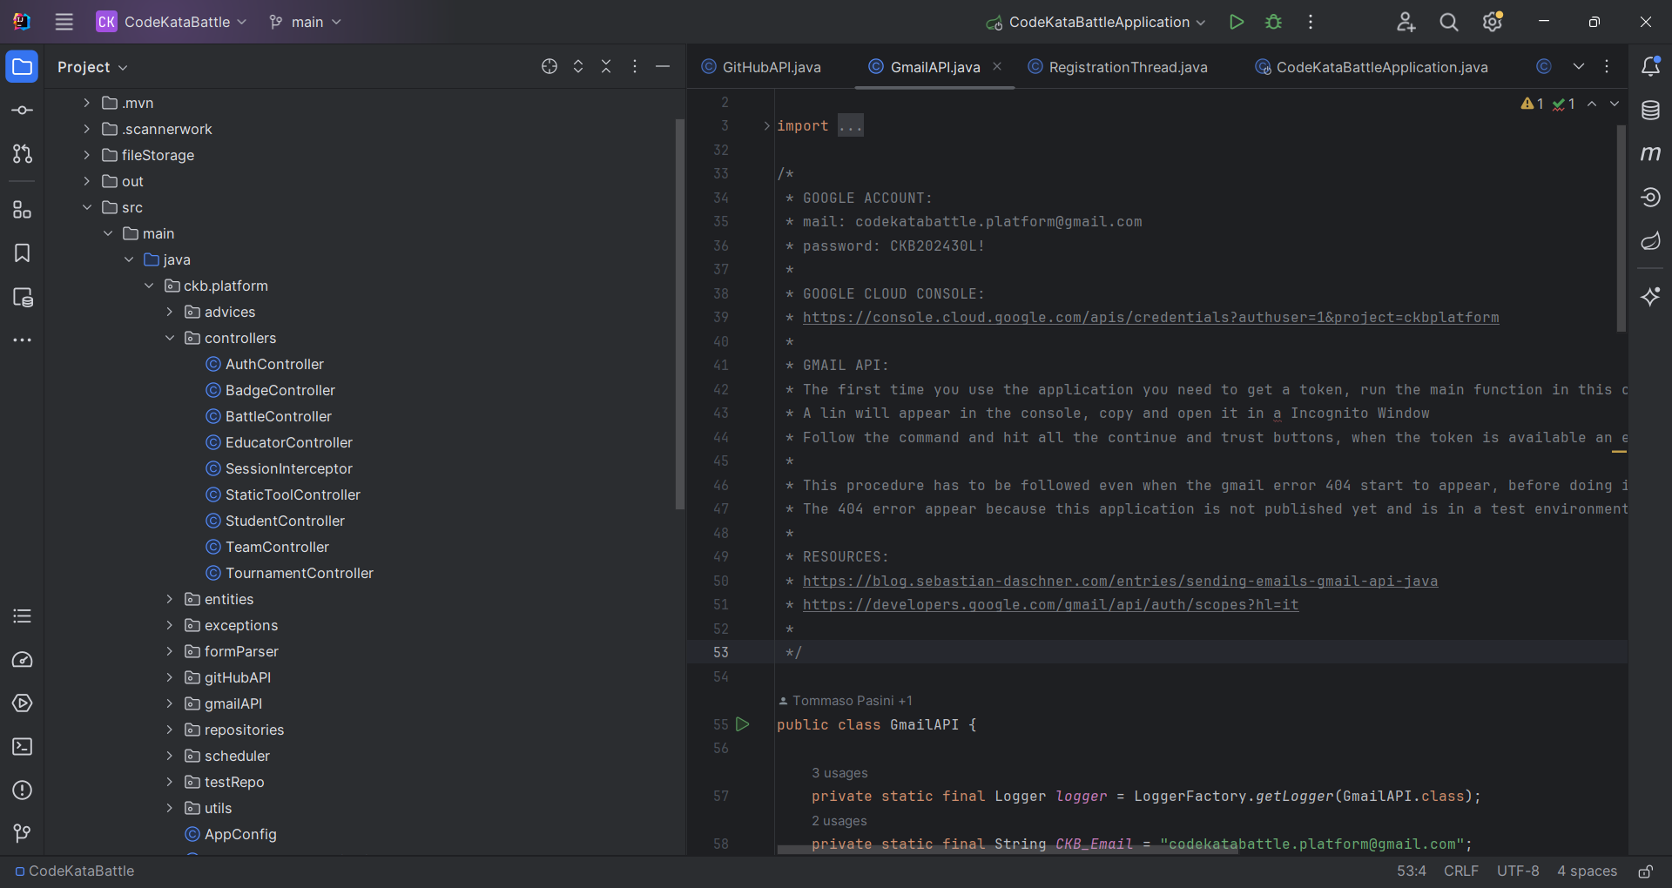
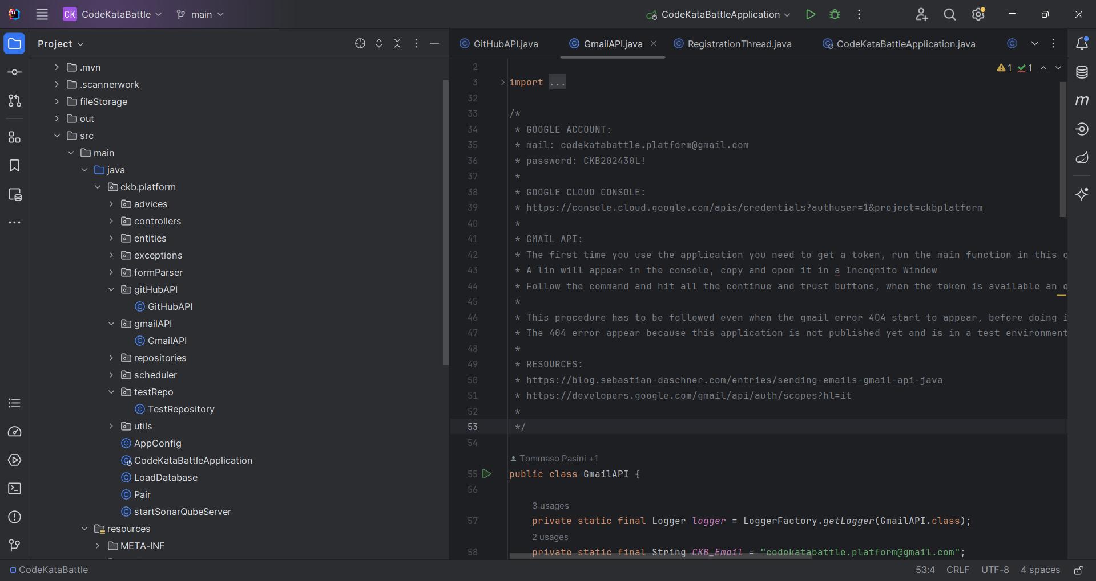
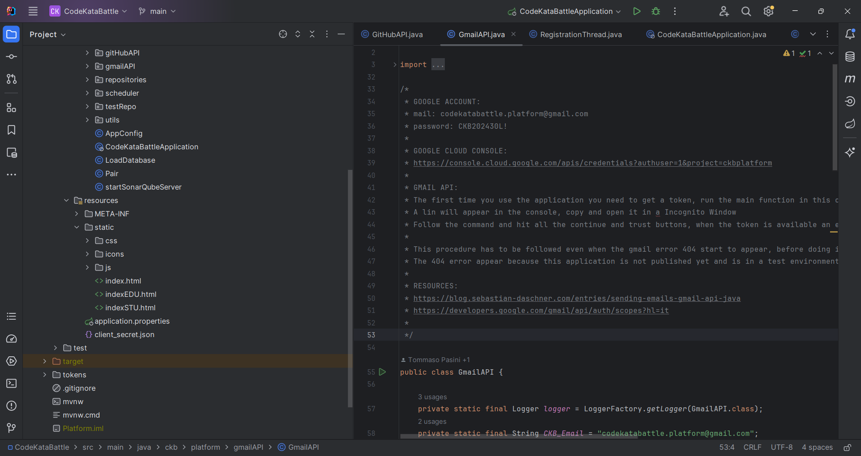
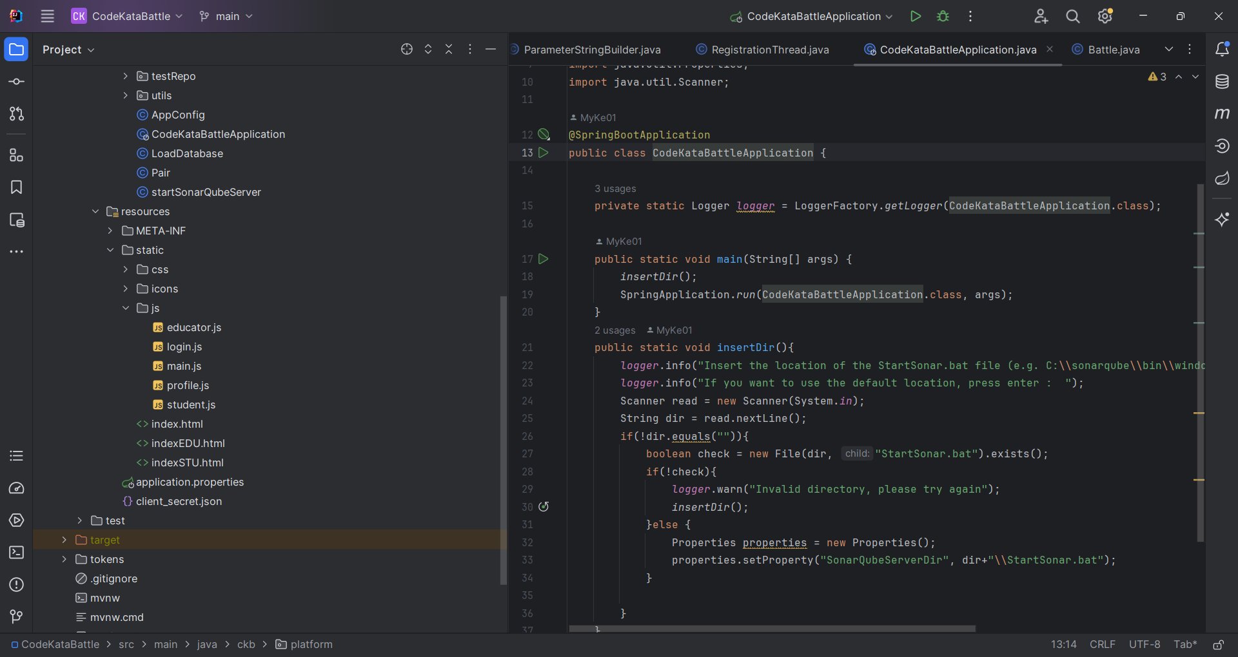
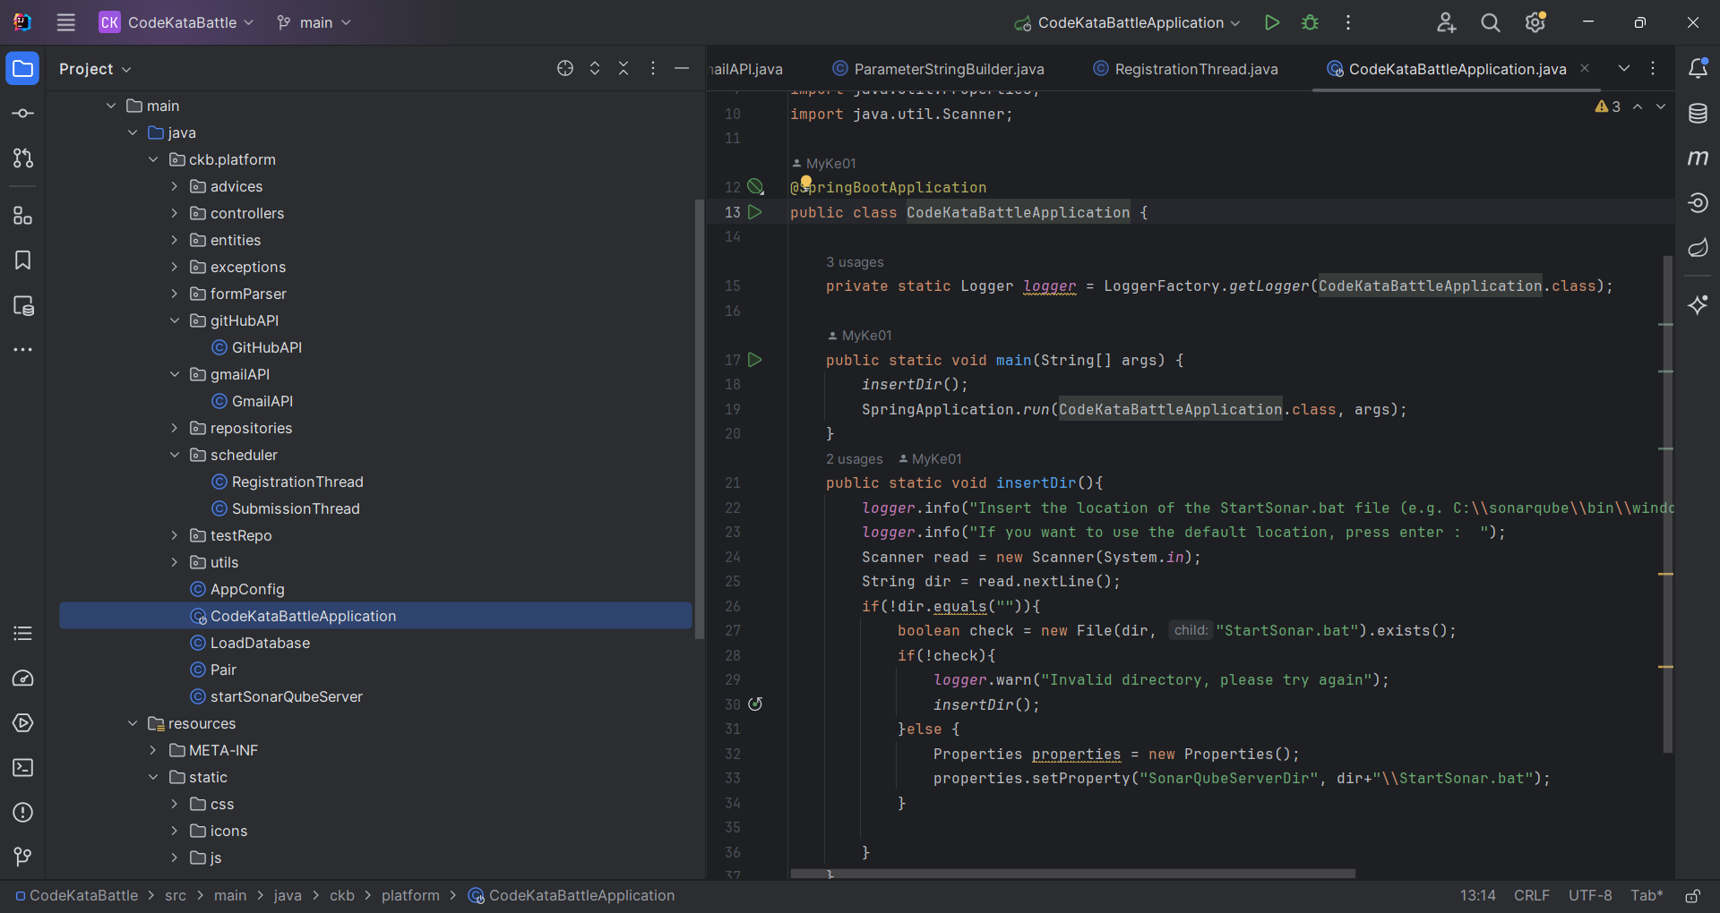
Code Structure

Slide 30
Mapping with DD
Component Diagram Modules | Classes and Packages
Profile Inspector | Class: StudentController
Query Manager | Package: Entities and Repository
Badges Manager | NOT IMPLEMENTED
Battles Manager | Class: BattleController and TeamController
Tournament Manager | Class: TournamentController
Auth Manager | Class: AuthController, check for session in every endpoint
Notification Manager | Package and class: GmailAPI
GitHub and Gmail API | Package and class: GitHubAPI and GmailAPI
Action Interfaces | JavaScript and Package: FormParser

Slide 31

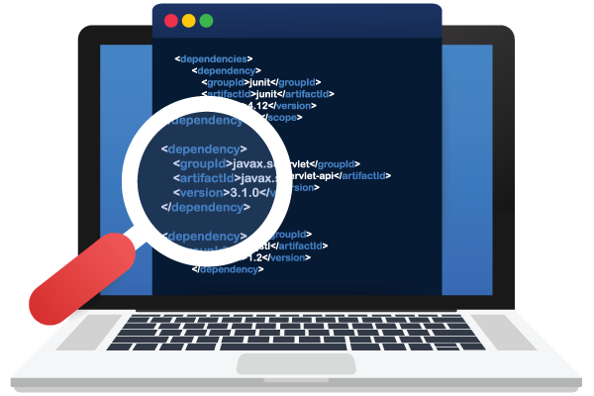

Test Cases
Incremental Approach
Main methods inside classes
Unit tests
Static Analysis
Behave as a malicious user

